Slide 1
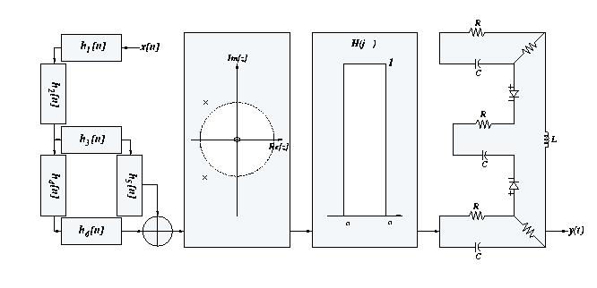
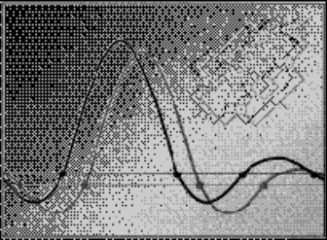
Signals and Systems
Spring 2007
Lecture #8
6 March 2007
Derivation of the CT Fourier Transform pair
Examples of Fourier Transforms
Fourier Transforms of Periodic Signals
Properties of the CT Fourier Transform

Slide 2

Fourier’s Derivation of the CT Fourier Transform
x(t) - an aperiodic signal
- view it as the limit of a periodic signal as T → ∞
For a periodic signal, the harmonic components are
spaced ω₀ = 2π/T apart ...
As T → ∞, ω₀ → 0, and harmonic components are spaced closer and closer in frequency
⇓
Fourier series Fourier integral

Slide 3
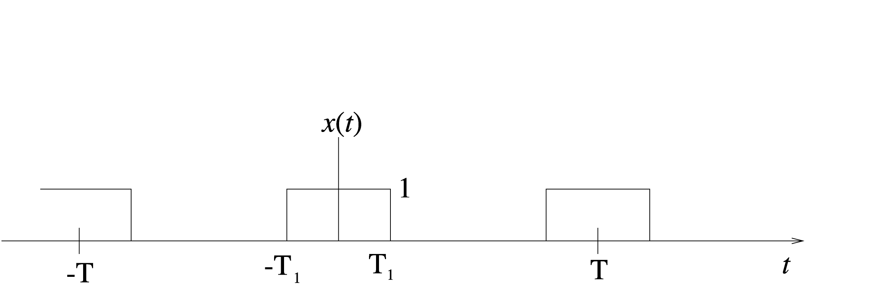
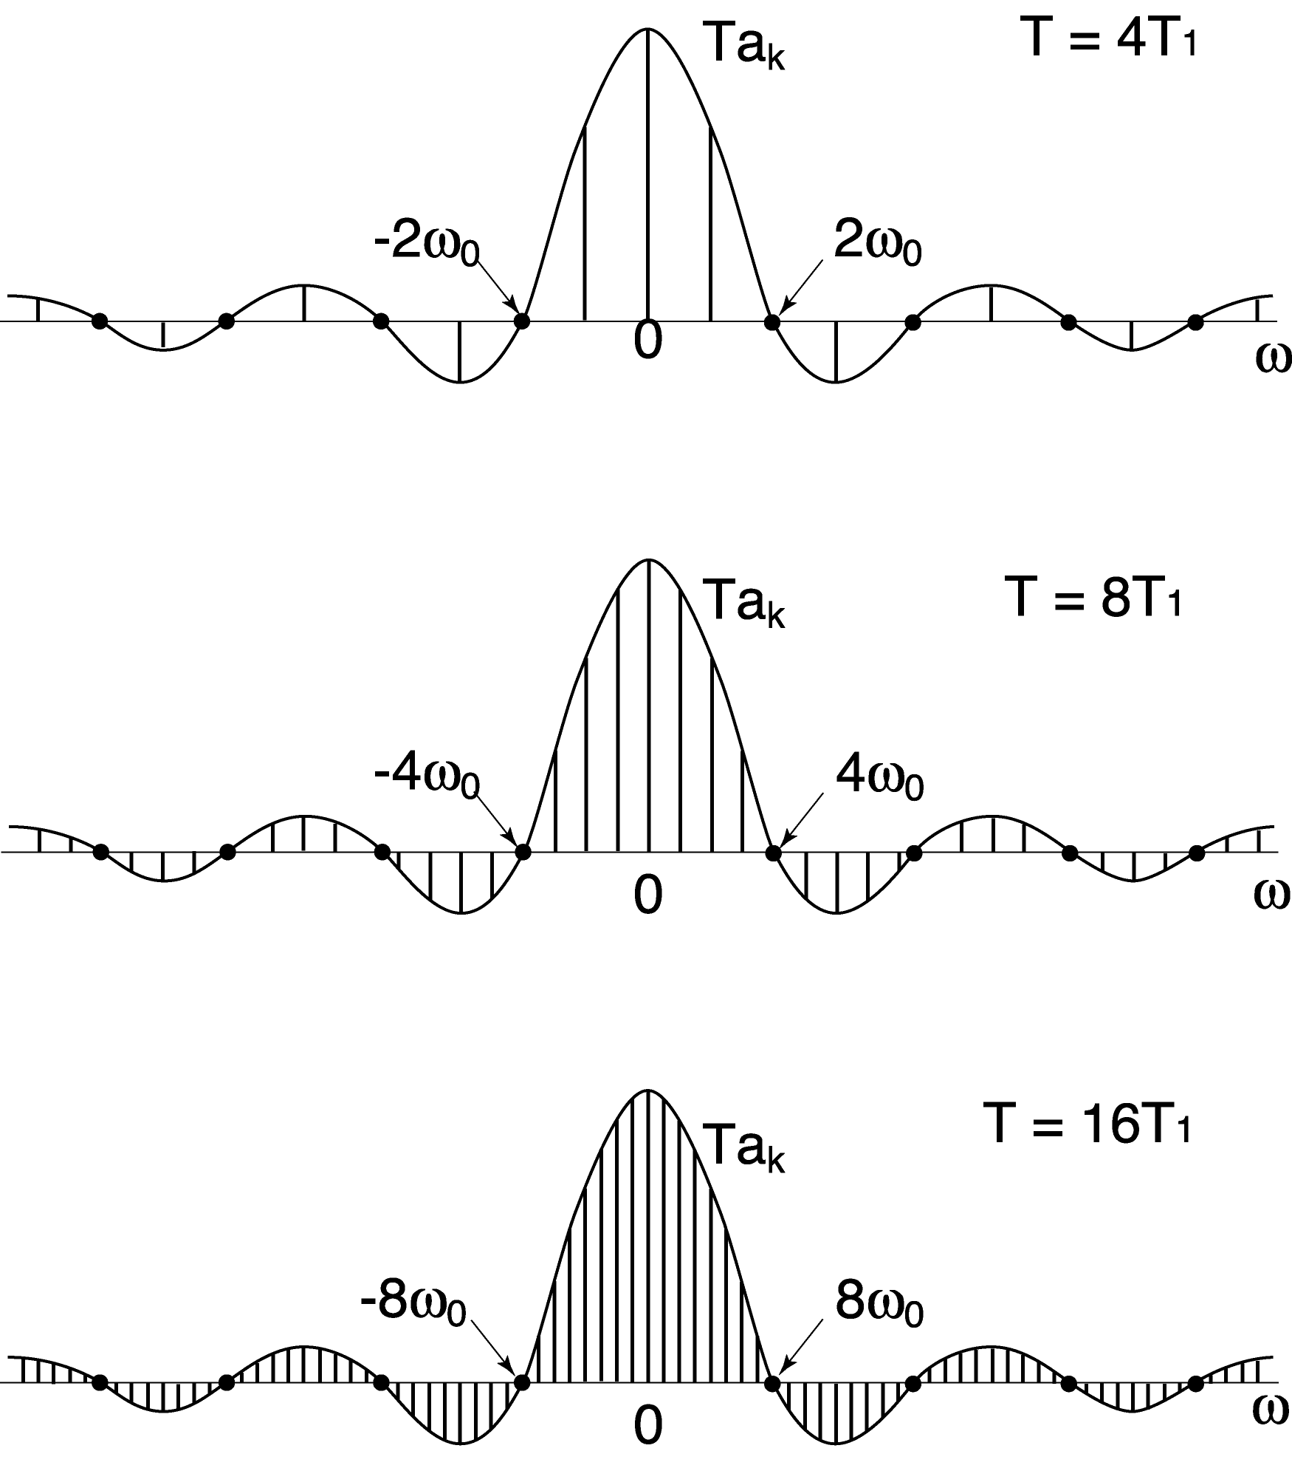
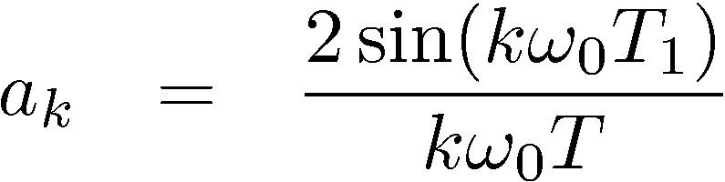
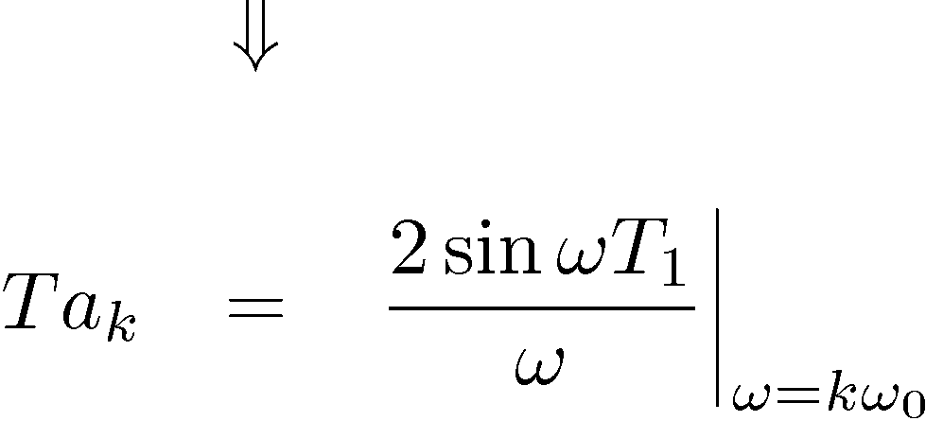
Motivating Example: Square wave
Discrete frequency points become
denser in
ω as T
increases

Slide 4
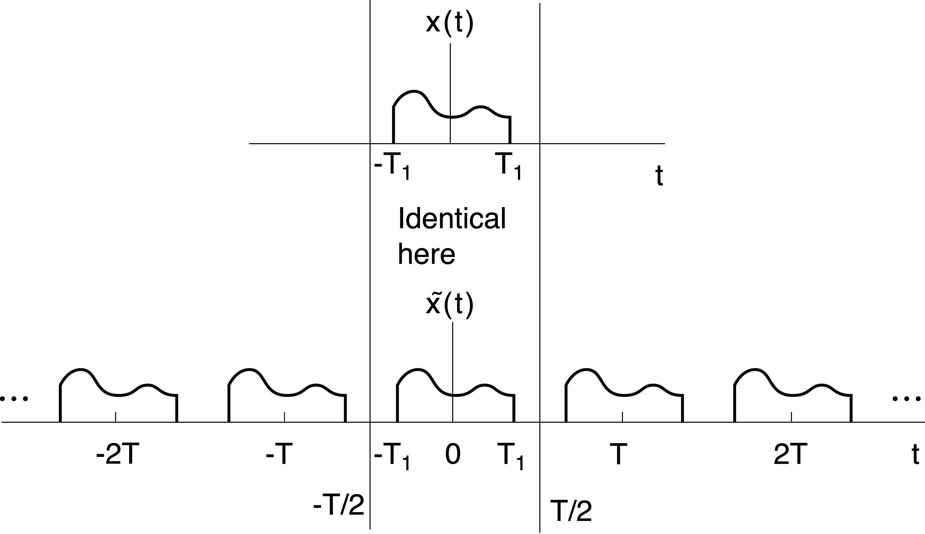
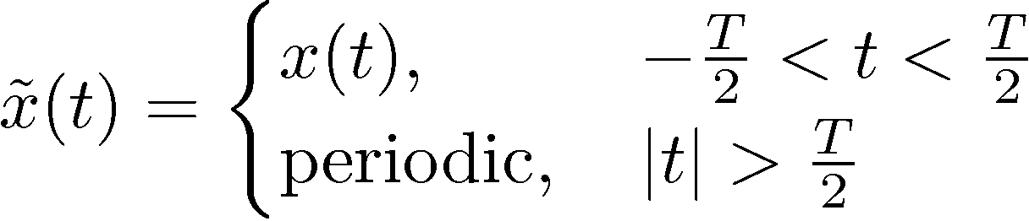
So, on with the derivation ...
For simplicity, assume
x(t) has a finite duration.

Slide 5
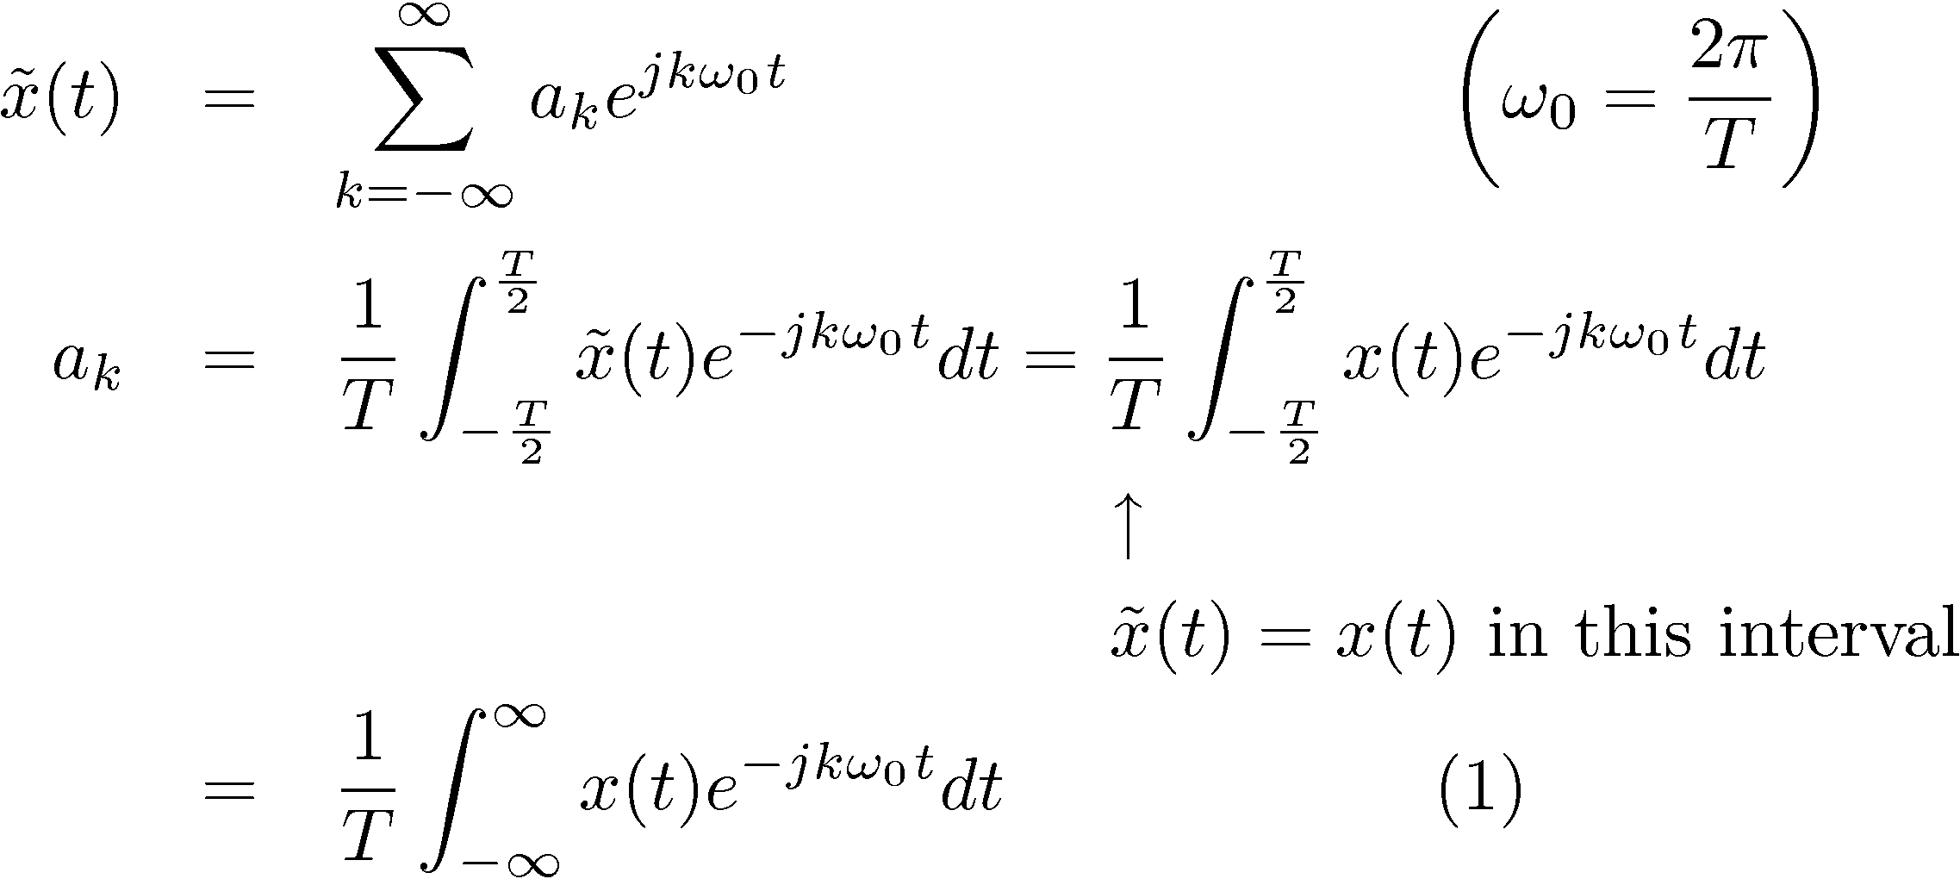
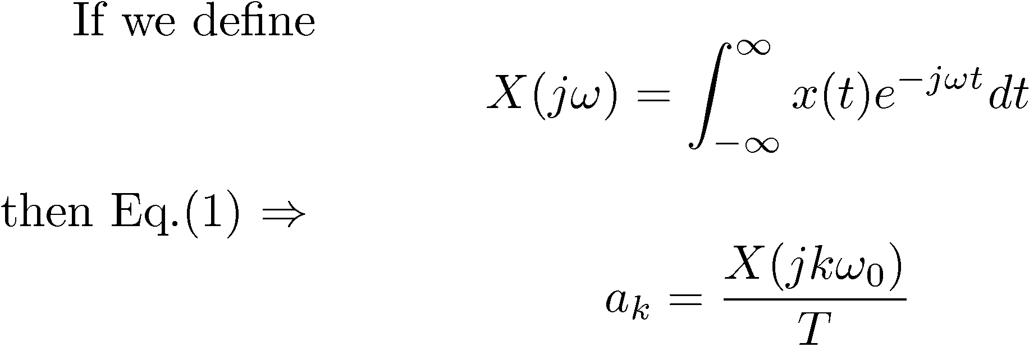
Derivation (continued)

Slide 6
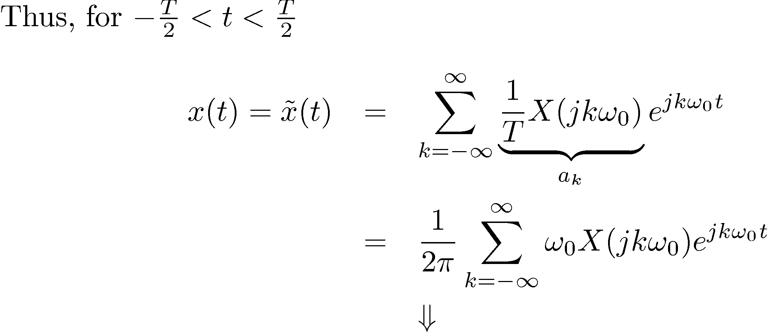
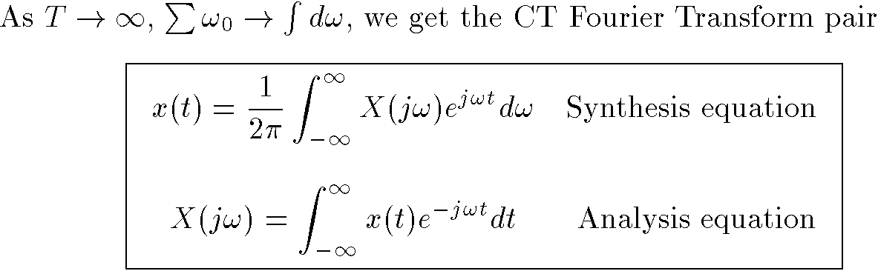
Derivation (continued)

Slide 7
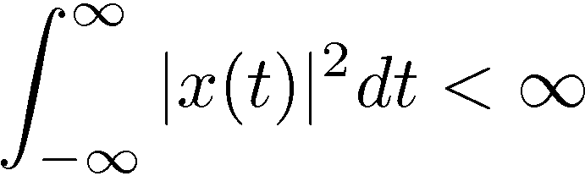
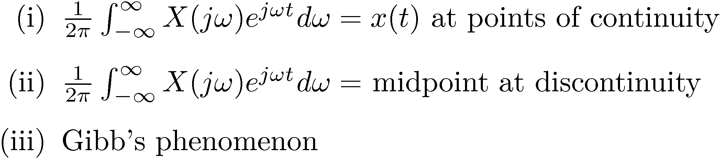
For what kinds of signals can we do this?
(1) It works also even if x(t) is infinite duration, but satisfies:
a) Finite energy
In this case, there is zero energy in the error
b) Dirichlet conditions (including )
c) By allowing impulses in x(t) or in X(jω), we can represent even more signals
E.g. It allows us to consider FT for periodic signals

Slide 8

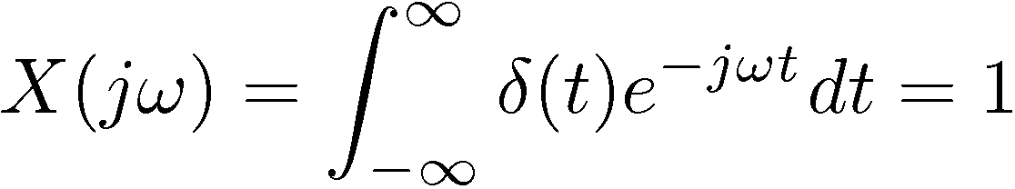
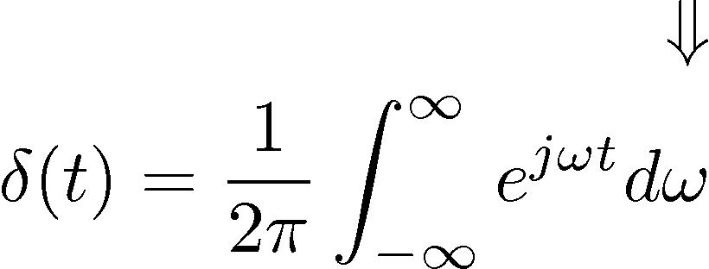

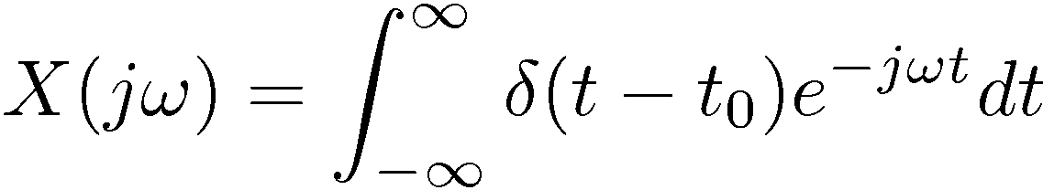

Example #1
(a)
(b)

Slide 9
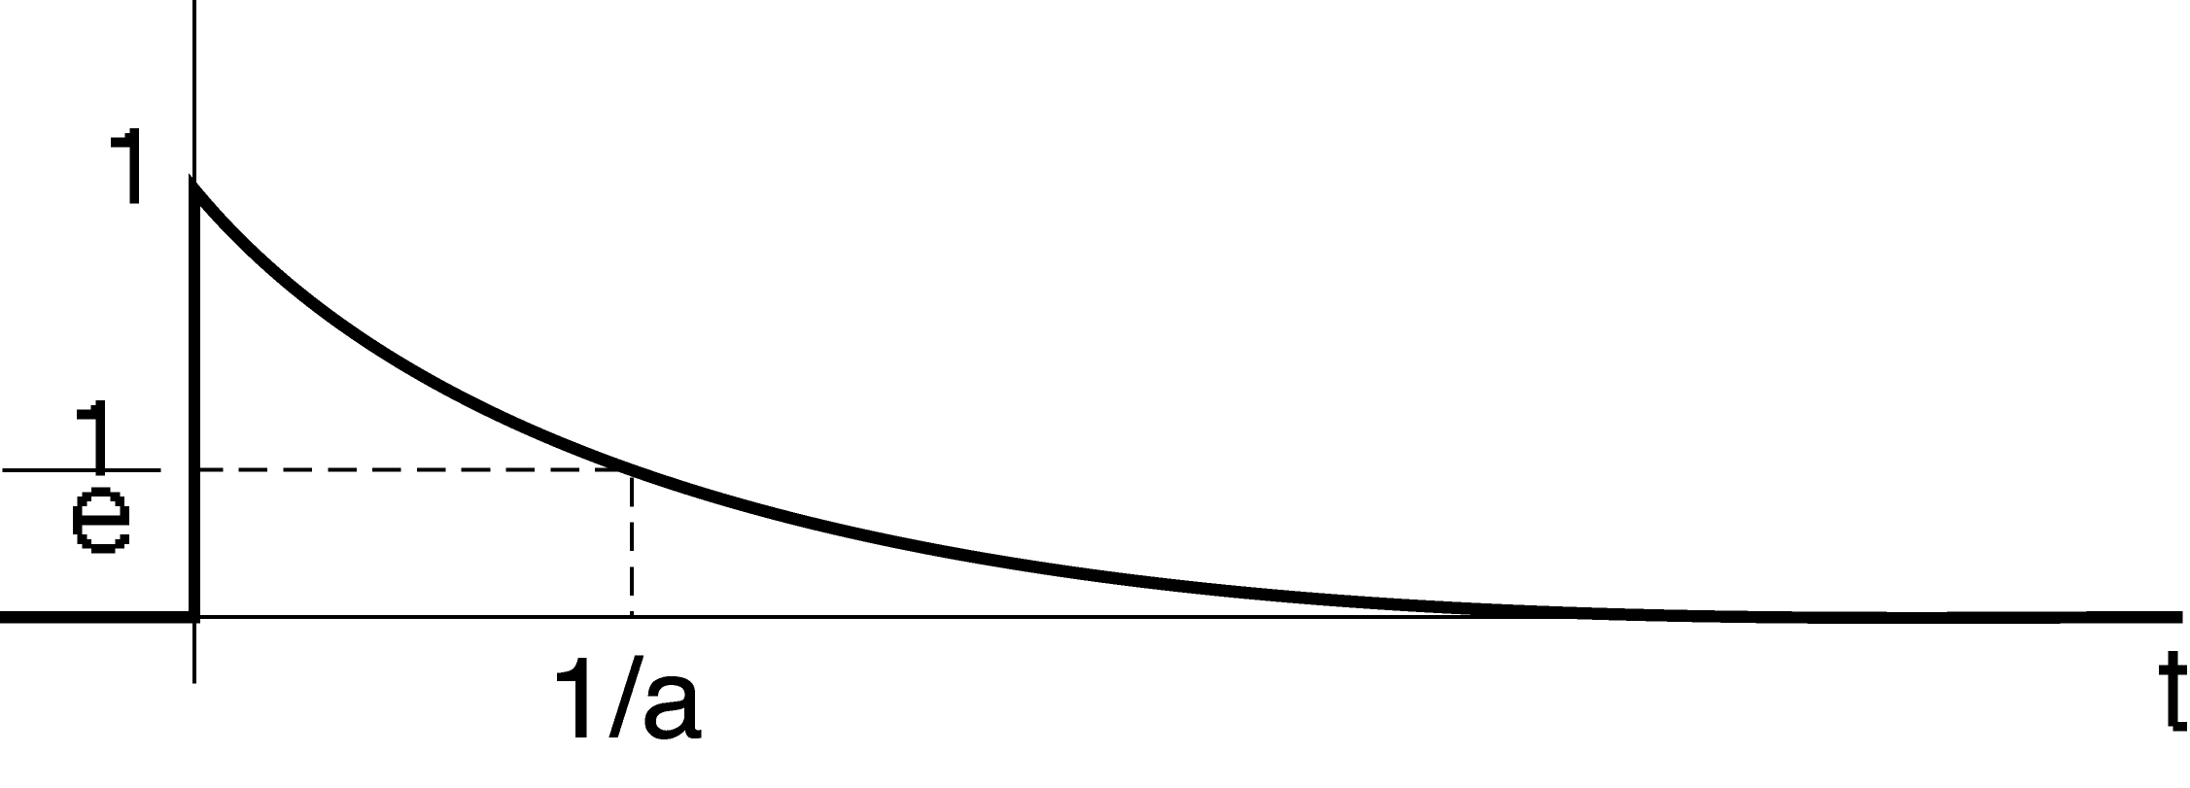
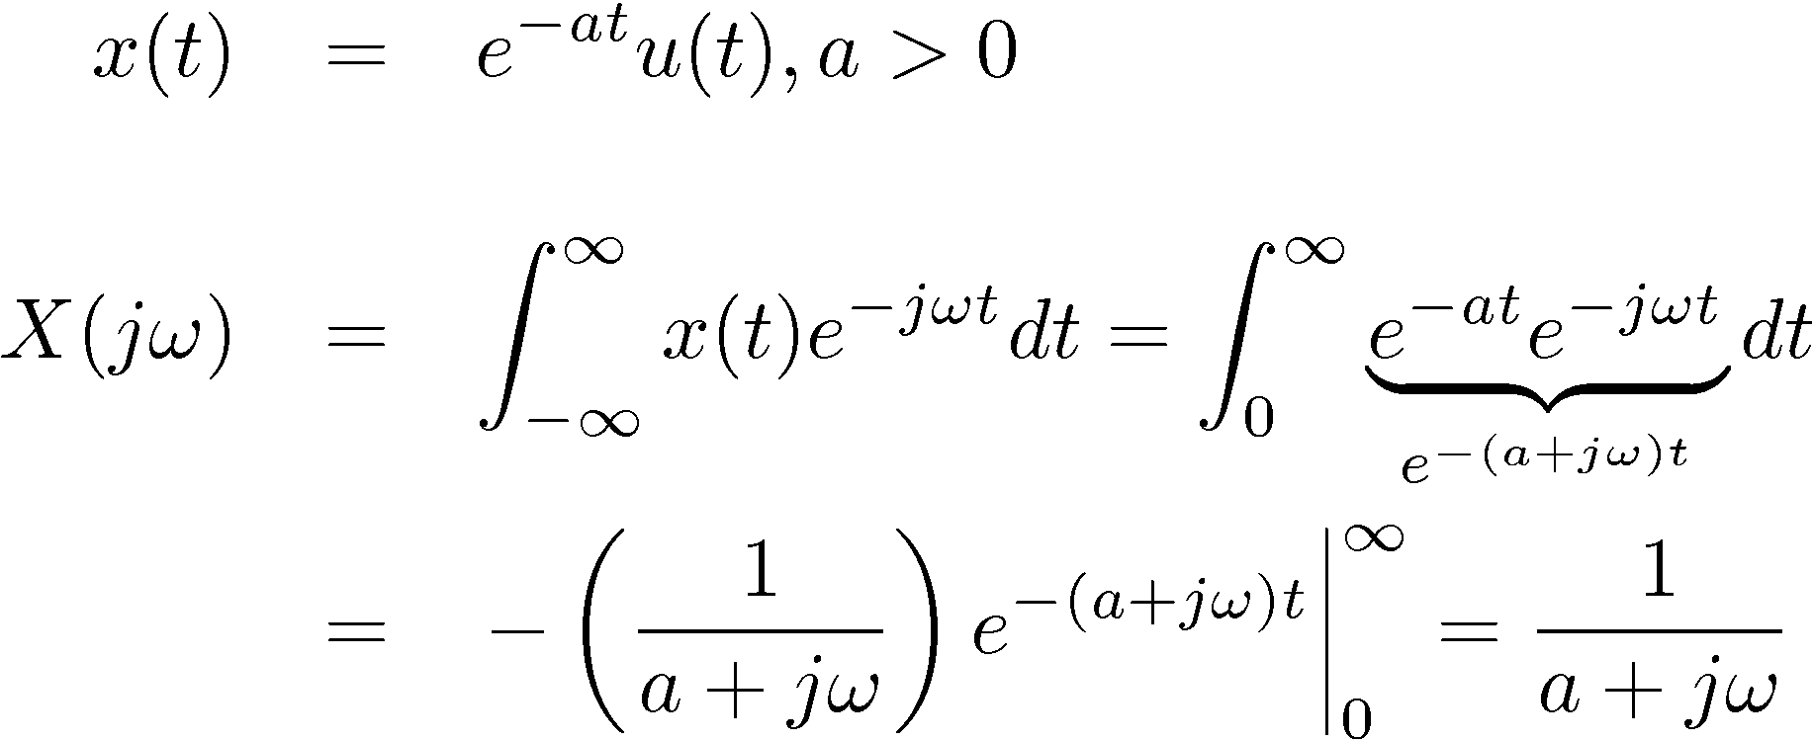
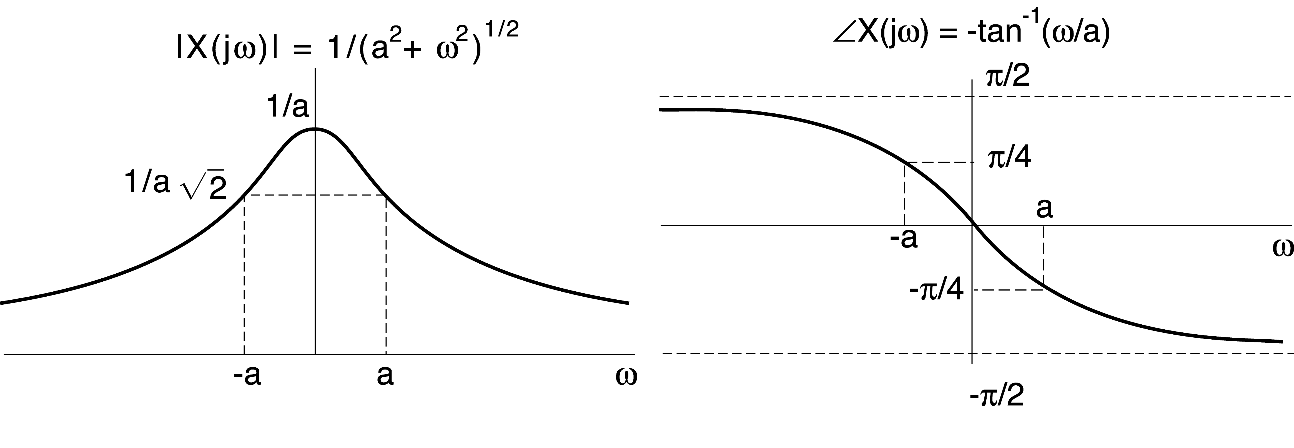
Example #2: Exponential function
Even symmetry Odd symmetry

Slide 10
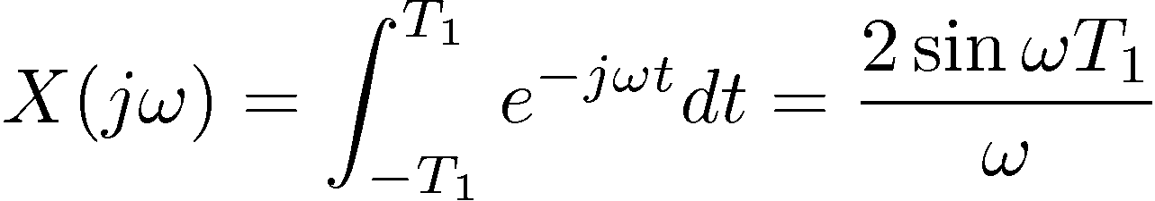
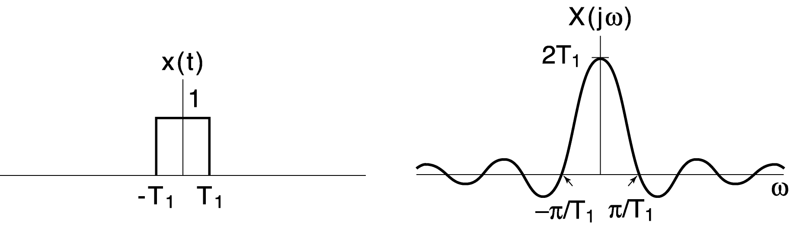
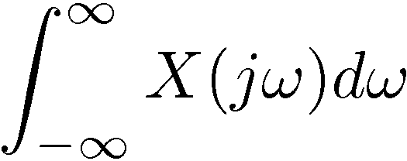
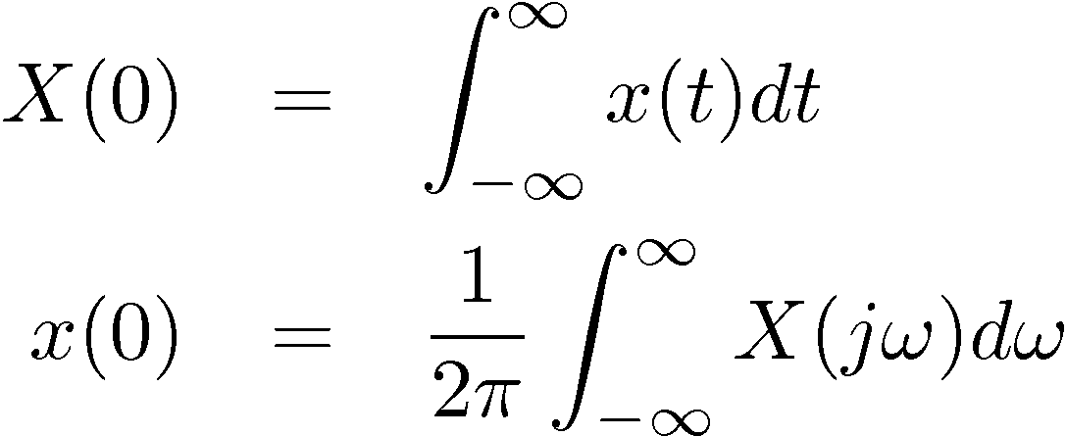
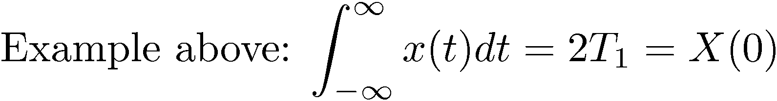
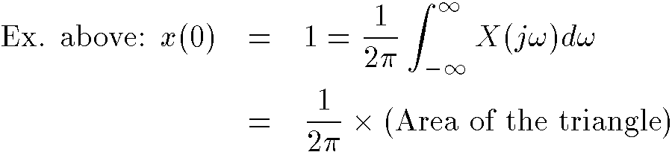
Example #3: A square pulse in the time-domain
Note the inverse relation between the two widths ⇒ Uncertainty principle
Useful facts about CTFT’s

Slide 11
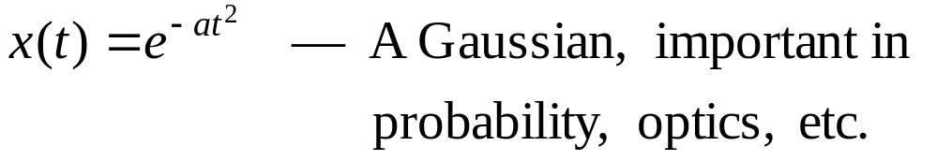
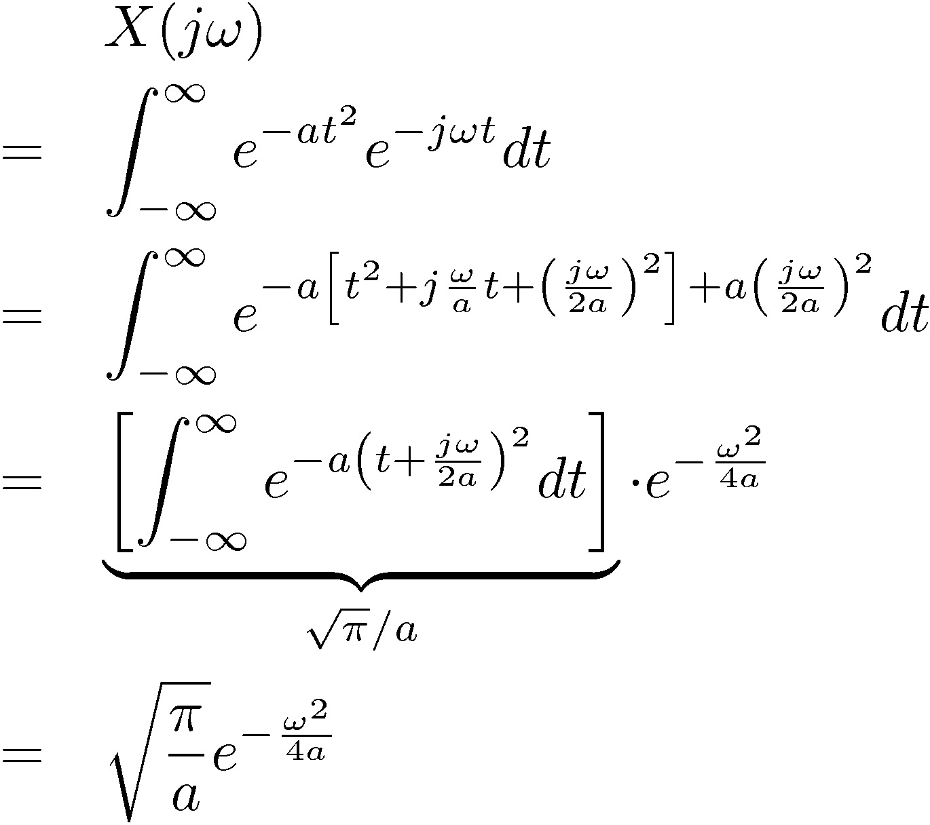
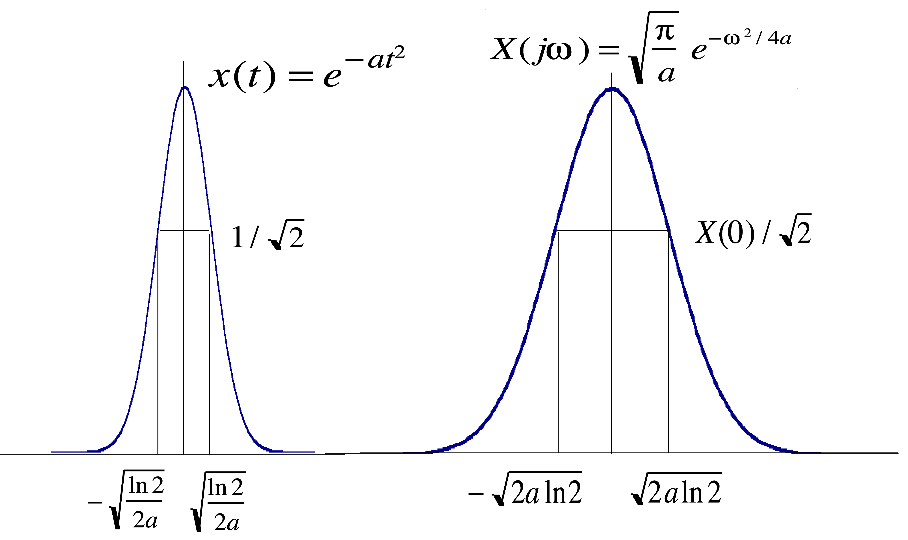
Example #4:
(Pulse width in t)•(Pulse width in ω)
⇒ ∆t•∆ω ~ (1/a^{1/2})•(a^{1/2}) = 1
Also a Gaussian!
Uncertainty Principle! Cannot make
both ∆t and ∆ω arbitrarily small.

Slide 12
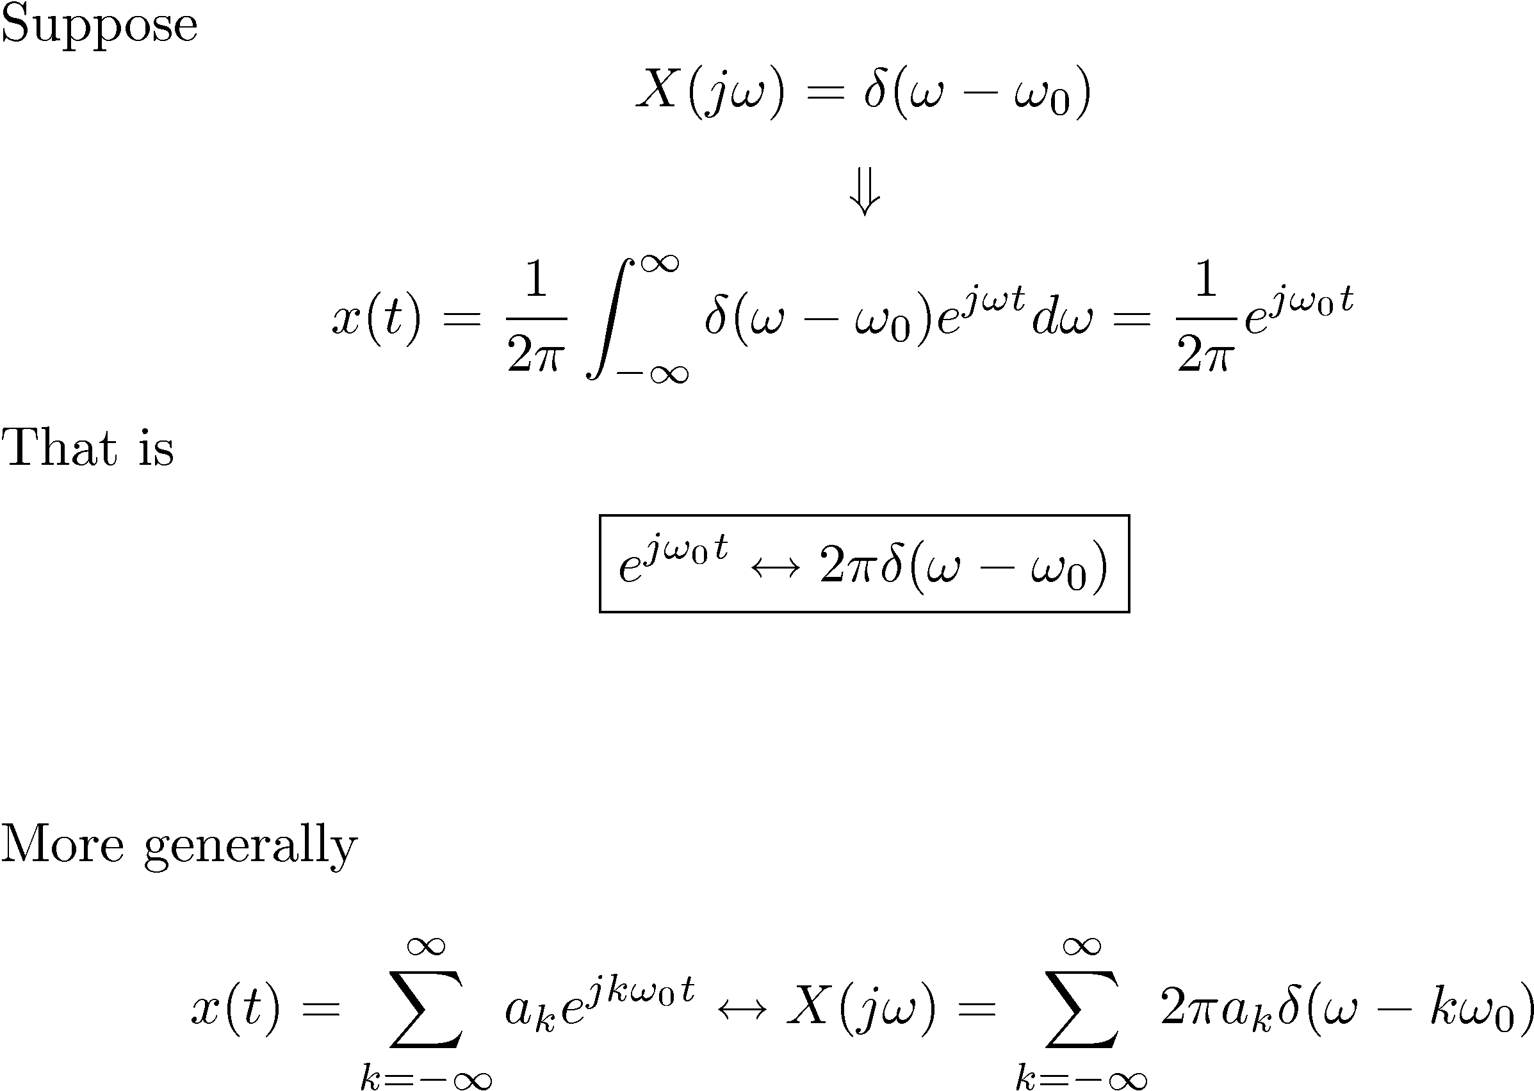
CT Fourier Transforms of Periodic Signals

Slide 13
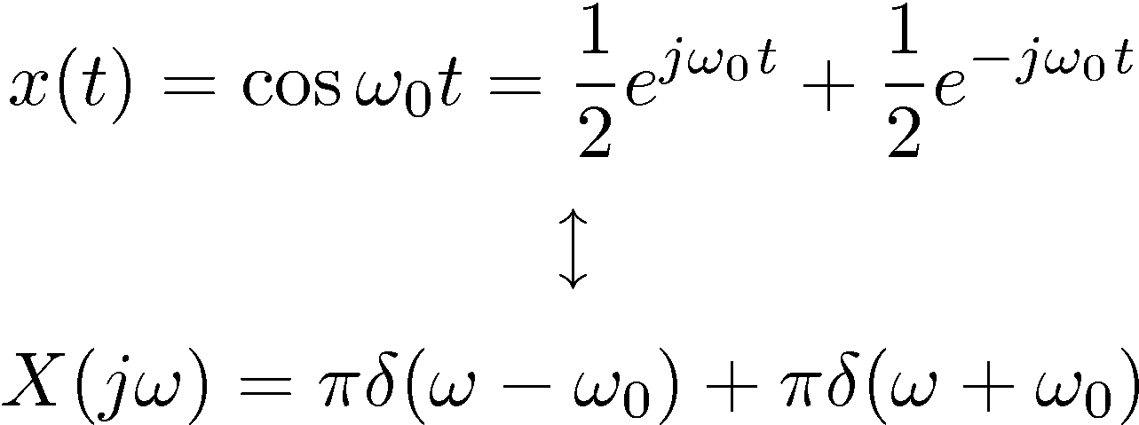
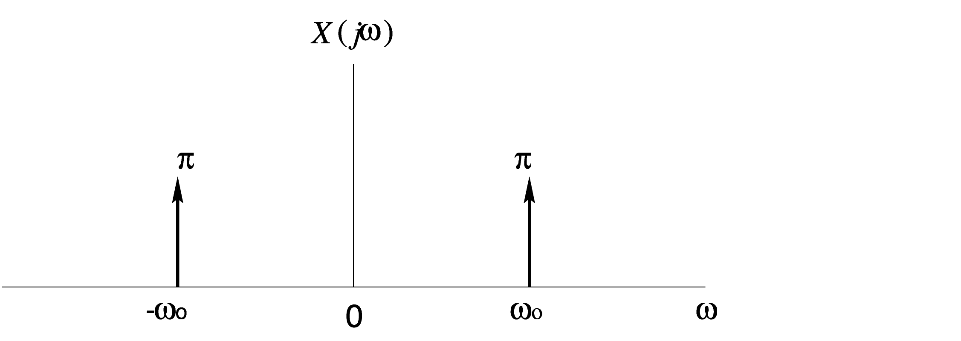

Example #4:
“Line spectrum”

Slide 14
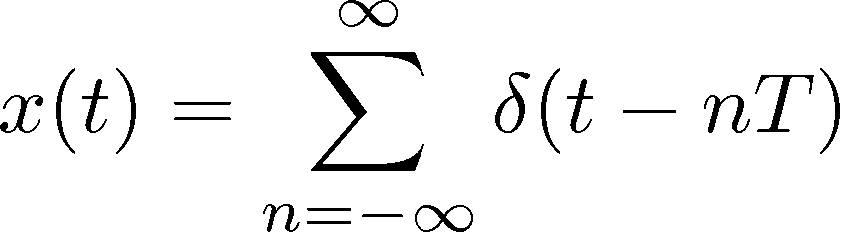
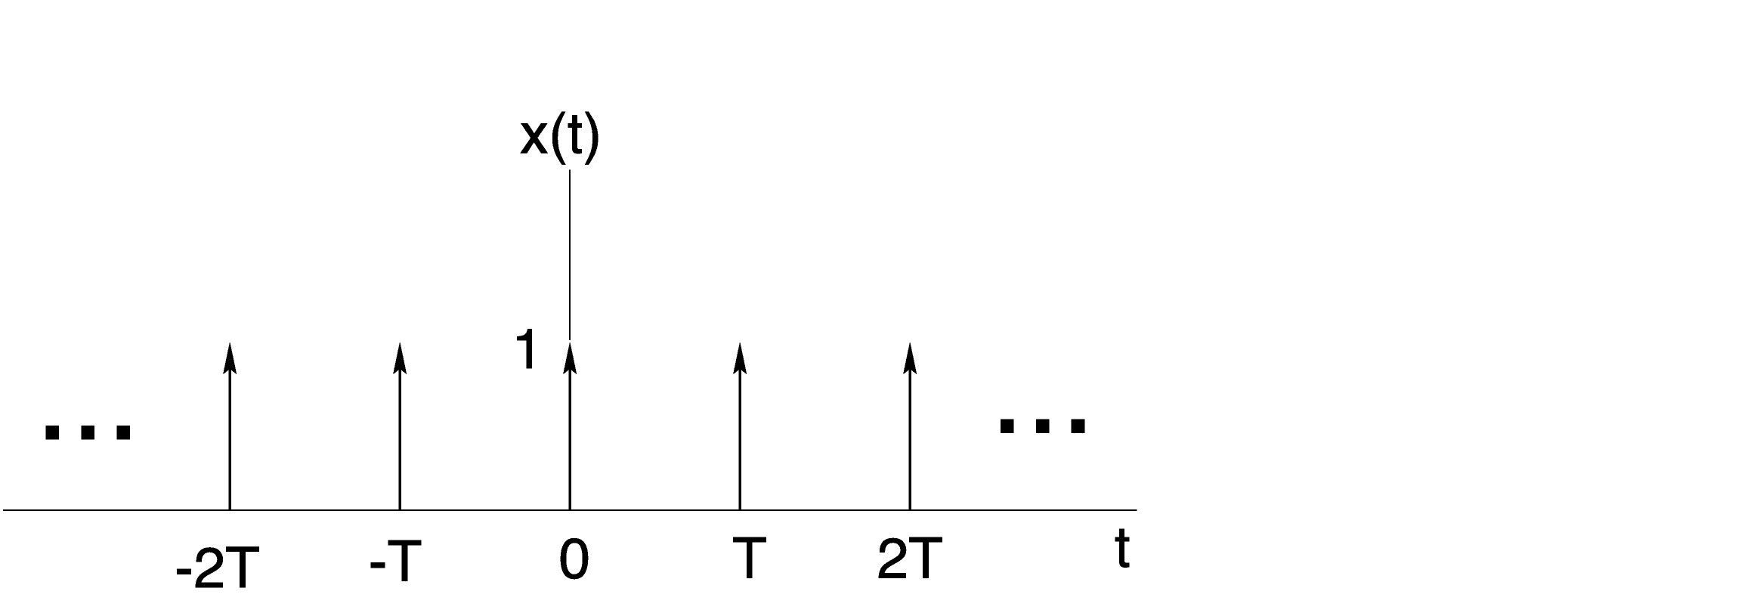
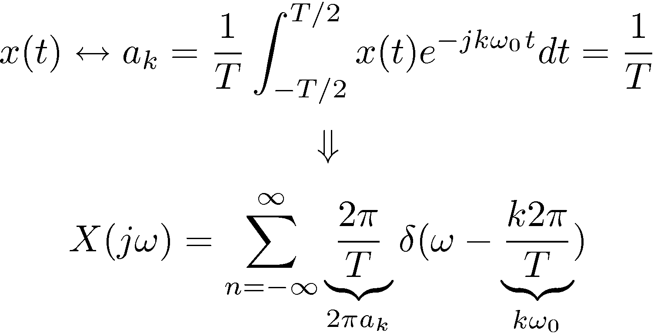
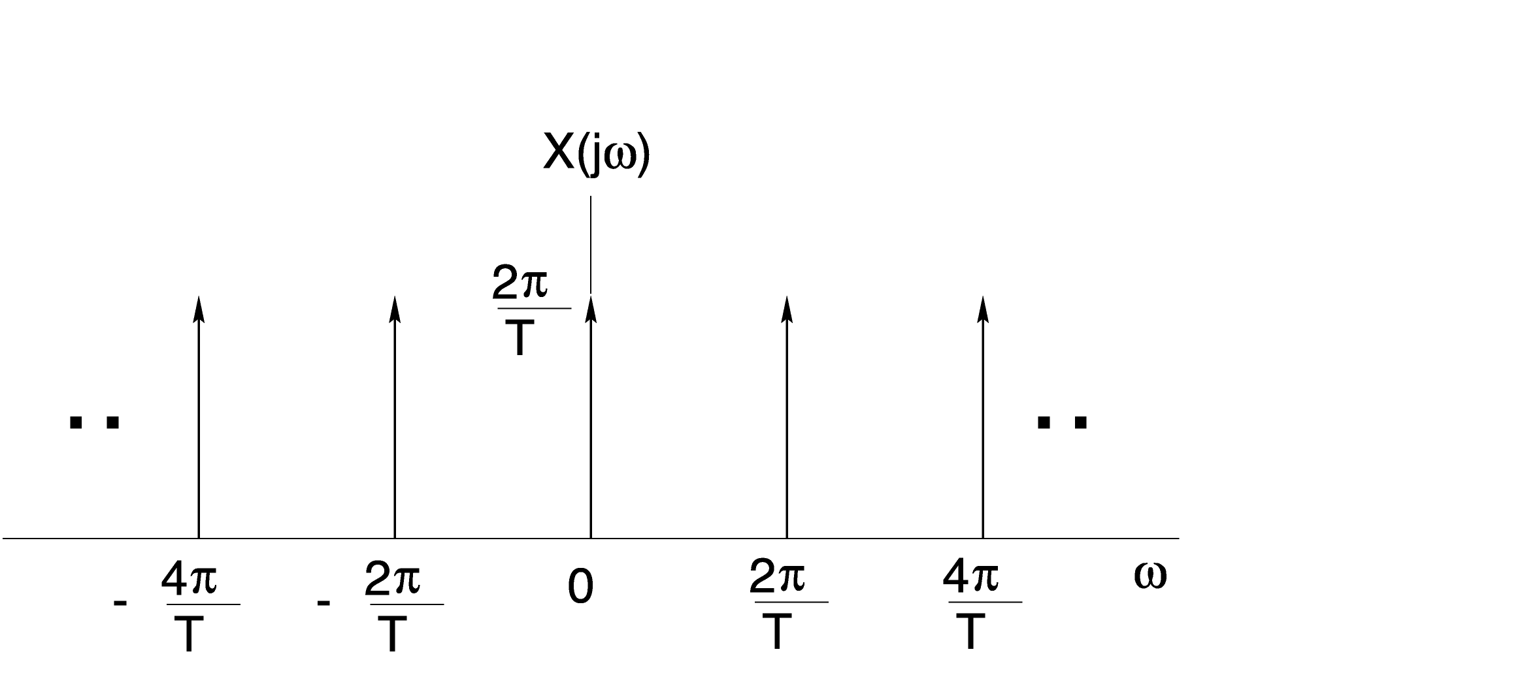
Example #5:
— Sampling function
Note: (period in t) T
⇔ (period in ω) 2π/T
Inverse relationship again!

Slide 15
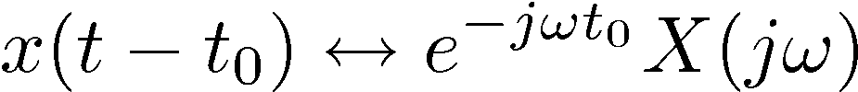
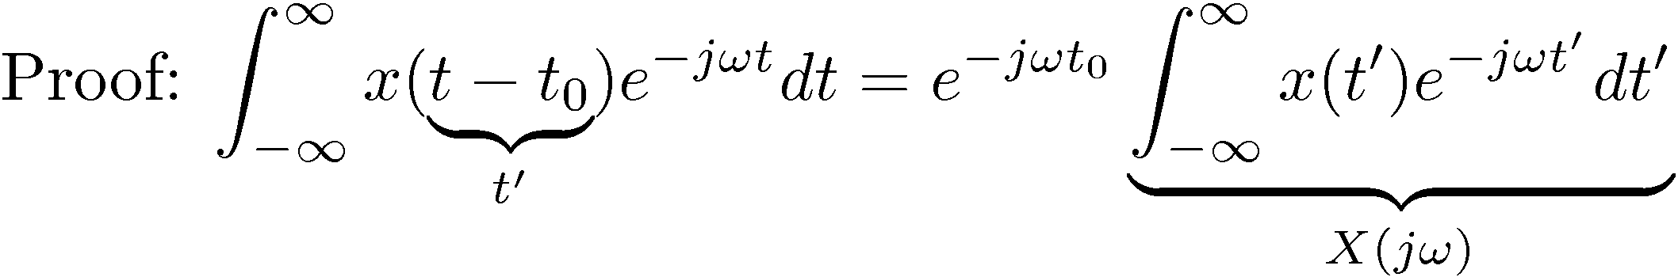
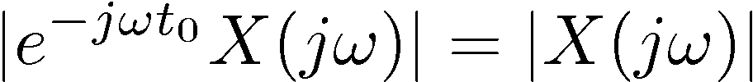
Properties of the CT Fourier Transform
Linearity
Time Shifting
FT magnitude unchanged
Linear change in FT phase

Slide 16
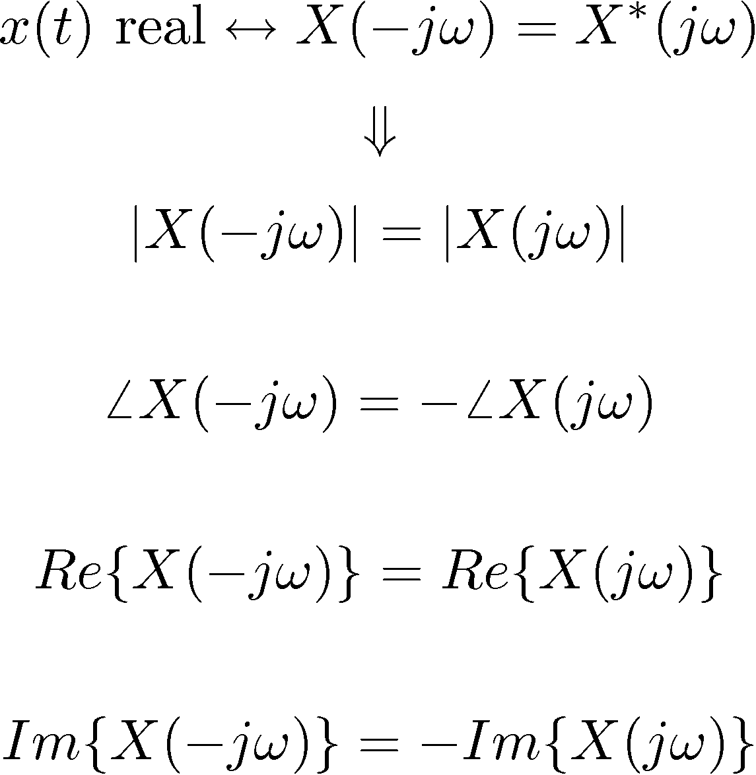
Properties (continued)
3) Conjugate Symmetry
Even
Odd
Even
Odd

Slide 17
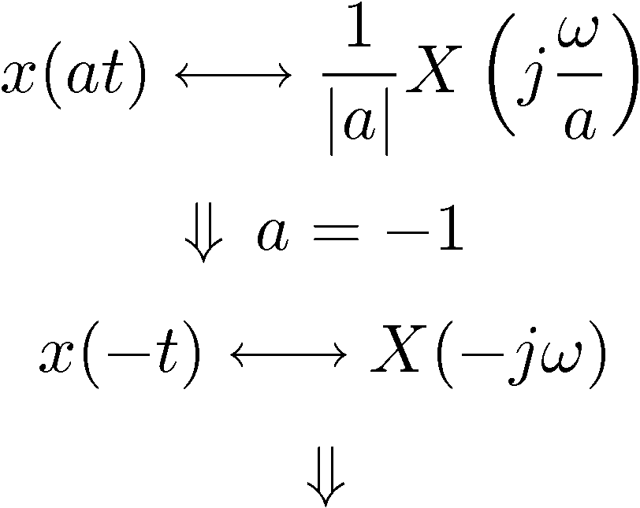
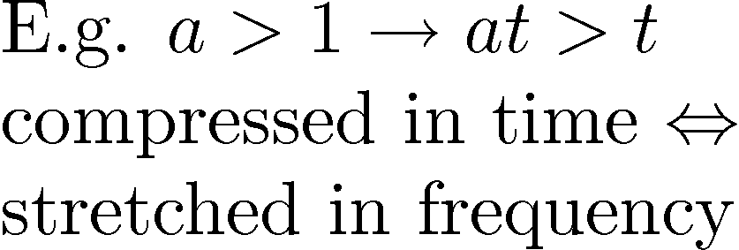
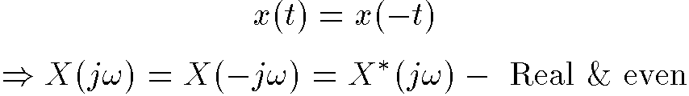
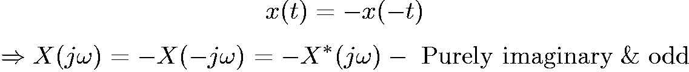
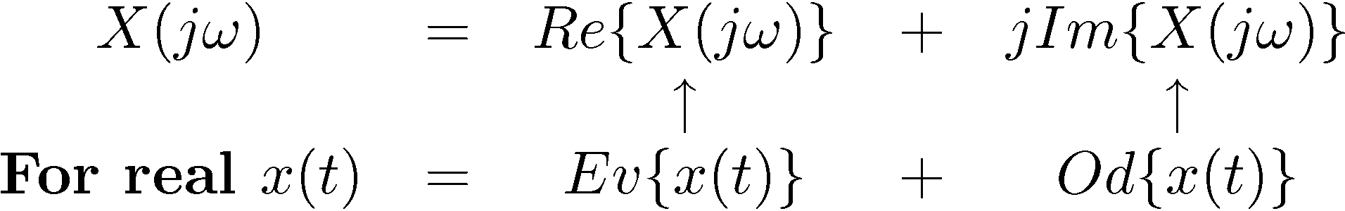
The Properties Keep on Coming ...
4) Time-Scaling
x(t) real and even
x(t) real and odd

